Slide 1
CORONARY HEART DISEASE PREDICTION USING LOGISTIC REGRESSION
QMST 5334: STATISTICAL METHODS
Team Members:
Anjali Goel
Akshitha Karthick Kumar
Harshal Y Shelare
Indu Dhulipala
Niharika Reddy Kota

Slide 2
AGENDA
Problem Statement
About Data & Variables
Descriptive Statistics & Outliers
Problem Approach
Bivariate Analysis
Assumptions
Model Building
Inferences
Conclusions

Slide 3
PROBLEM STATEMENT
WHO estimates 12 million deaths occurring worldwide every year due to heart diseases.
Early prognosis can aid in making decisions on lifestyle changes in high-risk patients and in turn reduce the complications.
Objectives:
To find out the most relevant/risk factors of heart disease
Predict the overall risk of having heart disease in the next 10 years.

Slide 4

ABOUT DATA & VARIABLES
Variable | Type
Sex (male = 1 = Male & male = 0 = Female) | Nominal
Age | Continuous
currentSmoker | Nominal
cigsPerDay | Continuous
BPMeds | Nominal
prevalentStroke | Nominal
prevalentHyp | Nominal
diabetes | Nominal
totChol | Continuous
sysBP | Continuous
diaBP | Continuous
BMI | Continuous
heartRate | Continuous
glucose | Continuous

Slide 5
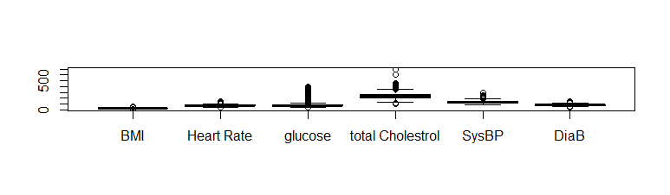
Descriptive Statistics and Outliers
The process of summarizing features from the collection of information
The columns BMI, HeartRate, glucose, totChol, SysBP, DiaBP columns contain outliers

Slide 6
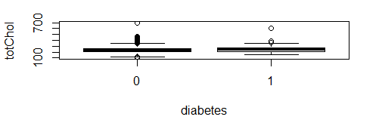
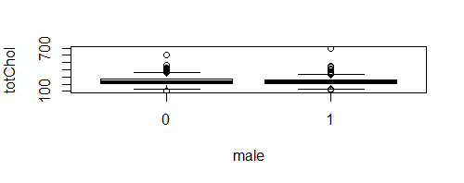
Descriptive Statistics and Outliers
Boxplot of total cholesterol ~ diabetes
Boxplot of total cholesterol ~ sex

Slide 7
PROBLEM APPROACH
Logistic Regression
R programming

Slide 8
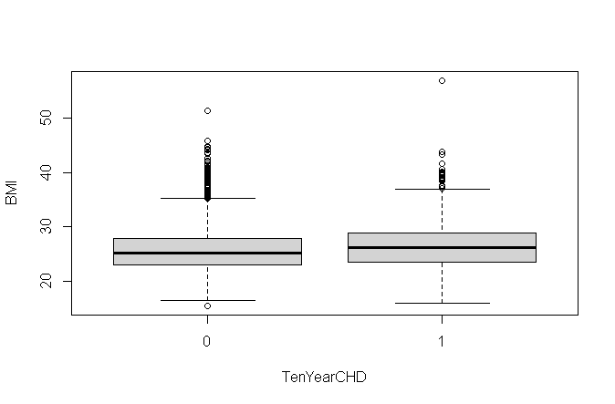
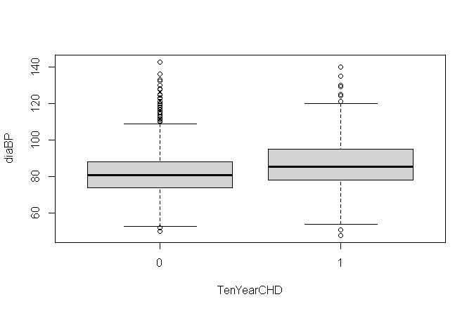
BIAVARIATE ANALYSIS
The diaBP is higher in people with ten-year than those without the risk of ten-year CHD
The median BMI is a little higher in people with ten-year CHD risk than those who do not have ten-year CHD risk.

Slide 9
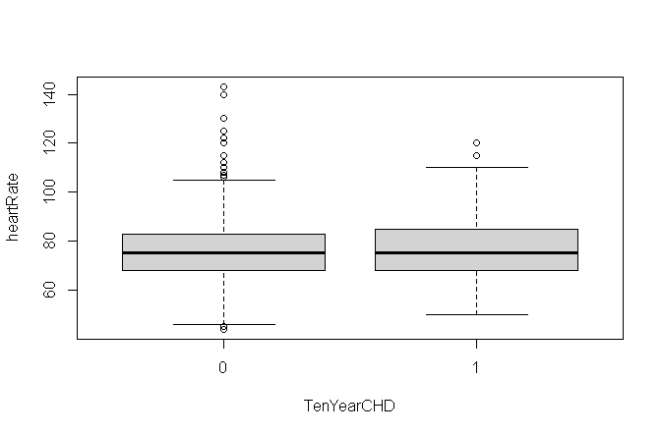
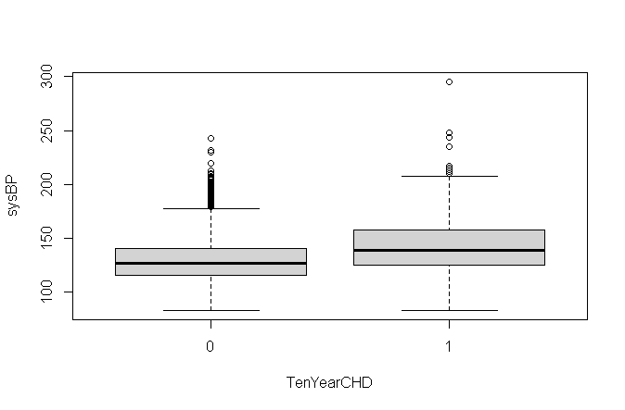
BIAVARIATE ANALYSIS (Cont..)
Most people with CHD risk have higher sysBP than people without the risk.
The number of people ranging from bottom to up in category 1 of TenYearCHD have higher average heart rate than people in category 0.

Slide 10
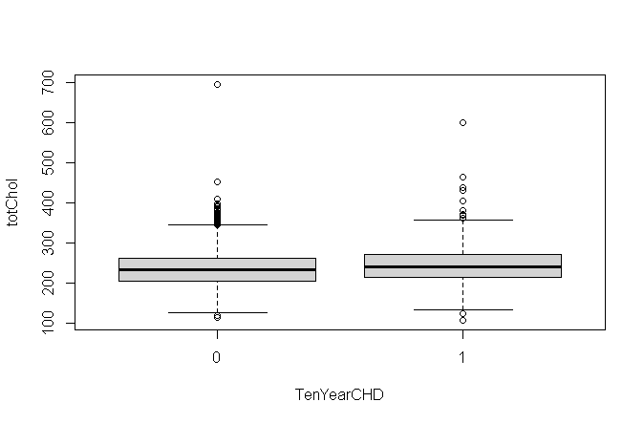
BIAVARIATE ANALYSIS (Cont..)
Total cholesterol in people with risk of CHD is higher than those without the risk of CHD.

Slide 11
ASSUMPTIONS
TenYearCHD column as dependent variable and age, sex, number of cigarettes smoked per day, and systolic Blood Pressure as the key independent variables of interest
Threshold value is set to 0.5 in the model as it is morally neutral
Dropped a column education – no significant role as a risk factor for the disease

Slide 12
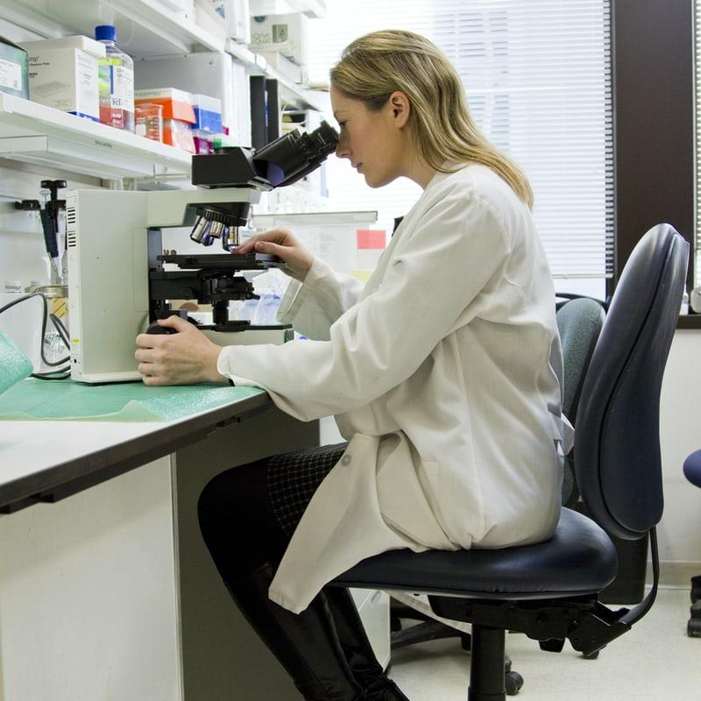
MODEL BUILDING
Step 1: Data cleaning and transformation
- to check and remove the missing values and insignificant variables
- Converting data type of categorical variables into factors

Slide 13
MODEL BUILDING (Cont..)
Step 2: Building Logistic regression model
- Data sampling for regression modelling
- modelling of logistic regression model
- Hypothesis test 1
- Hypothesis test 2

Slide 14
BEST MODEL
The Regression model built with independent variables totChol, sysBP, diabetes, age, currentSmoker, sex, prevalent Stroke, and diaBP​ with the threshold 0.04

Slide 15
PREDICTIONS
Step 1: Using predict method on the test dataset
Step 2: Estimating accuracy for the predicted model

Slide 16
INFERENCES
In Hypothesis test 1, we accept alternate hypothesis (H_{a}), model fits better with independent variables
In Hypothesis test 2, we accept alternate hypothesis (H_{a}) , complicated model is better fit
AUROC = 0.52 > initial threshold (0.5), model generates more than 52.3% correct results
Specificity = 0.98, fewer false positives
Sensitivity = 0.06, more false negatives
Overall accuracy = 84.27% for independent variables totChol, sysBP, diabetes, age, currentSmoker, sex, prevalent Stroke, and diaBP
Performance of the predicted model decreases to 85
% when independent variables age, sex or current smoker are not included
Accuracy = 93.75%, model rightly predicted people with heart disease

Slide 17
CONCLUSIONS
Found the potential risk factors of coronary heart disease
Predicted the number of people who are at risk using logistic regression.
Model trained and generated predictions with an accuracy of 93.75% with optimal threshold of 0.04

Slide 18

THANK YOU!

Slide 19
QUESTIONS?

